Slide 1
Hotel Cancellation Prediction

Slide 2
Major Learning from the Project
Identifying Data is linearly separable or not
Finding co-relation between Categorical Variables
Using Chi-Square and ANOVA for feature selection

Slide 3
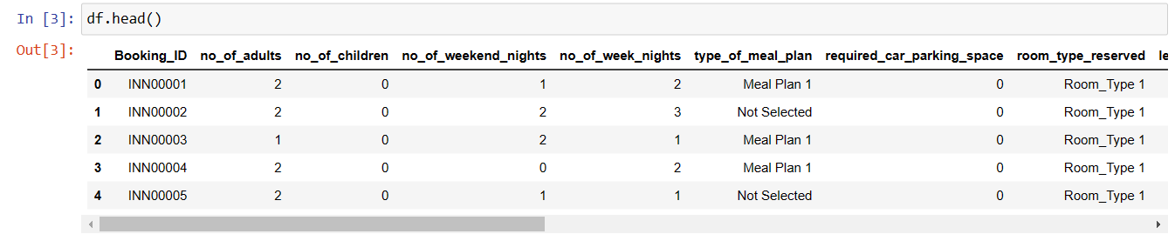
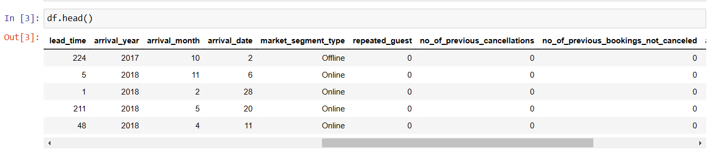
Dataframe

Slide 4
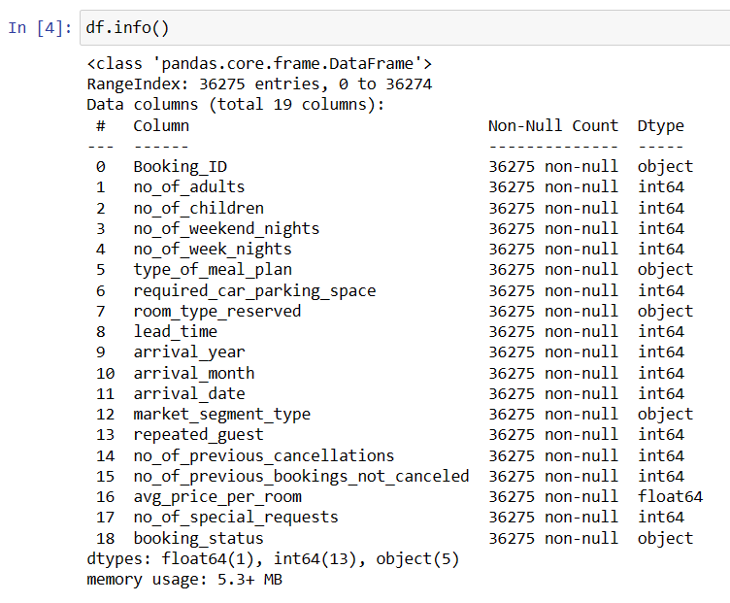
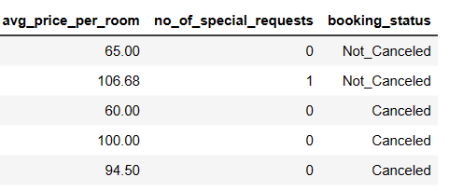
Dataframe

Slide 5
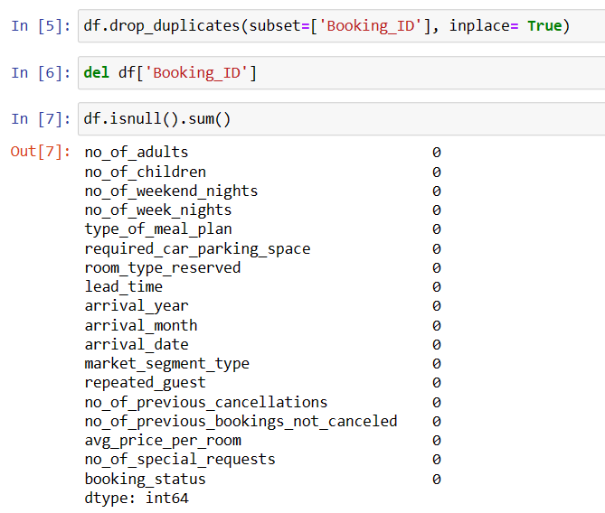

Slide 6
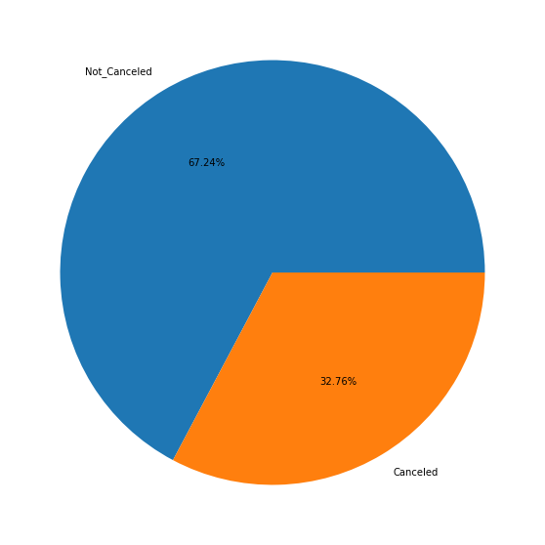

Slide 7
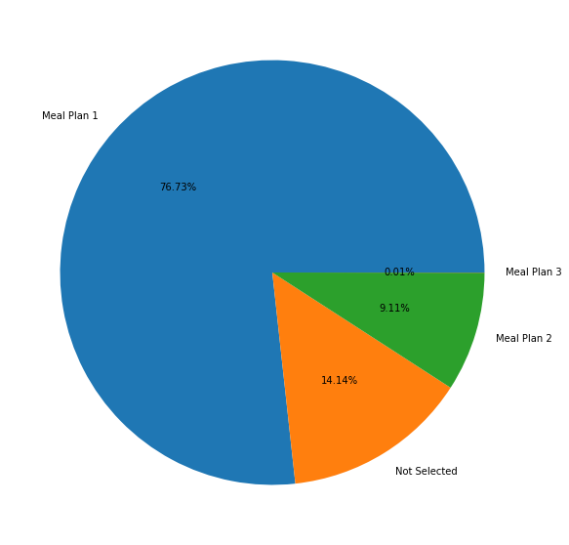
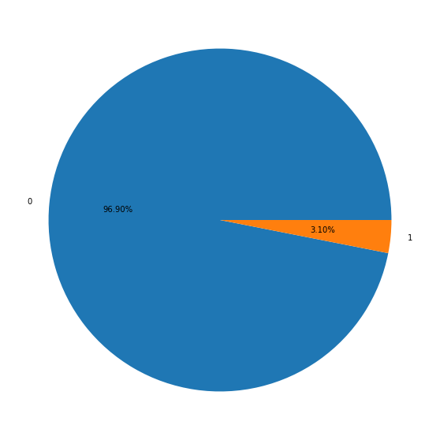
Meal Plan
Car Parking Requirement

Slide 8
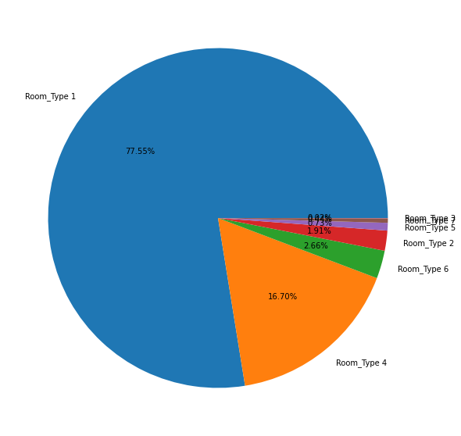
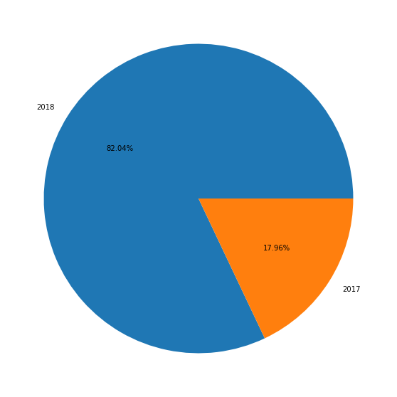
Room Type
Year of Booking Data

Slide 9
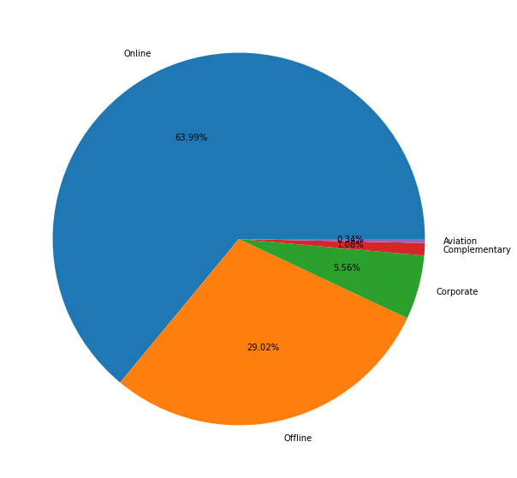
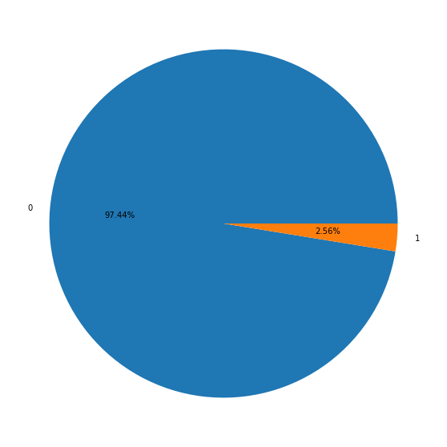
Channel Of Booking
Repeated Customer Spread

Slide 10
# From the above pie charts below are inferences
# Around 30% of the cancel after booking
# Majorly 76% select booking with meal plan 14% do not select any meal plan. May be the hotel can look to remove other meal plans.
# 96% of people do not require parking.
# Room_type 1 booking is around 77%, Room_type booking is around 16%
# 82% booking happened 2018,
# 64% booking happens online, 30% booking happens offline
# Only 2.5% are repeated guest
# From the above pie-chart we have found out the major contributors which affects Cancelling and Not Cancelling

Slide 11
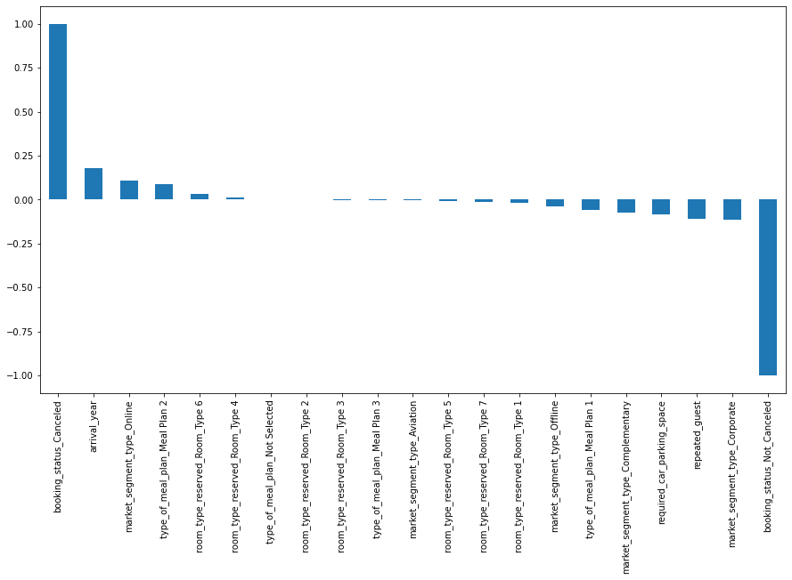
# Few good things observed from the above plot, Corporate bookings, repeated guests, Meal Plan 1, Room Type 1 -ve related to cancellation.
# Room Type 1 with Meal Plan 1 are majority of the guest
# Hotel needs to focus to increase corporate guests and repeated guests

Slide 12
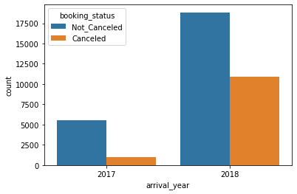
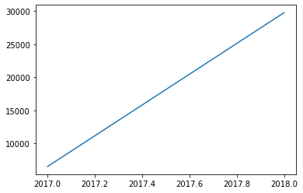
# Looks like data is missing for certain part of the year in 2017
# df_year_month = df[['arrival_year', 'arrival_month']]

Slide 13
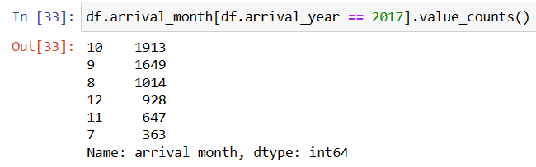
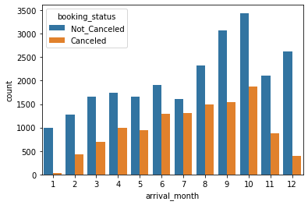
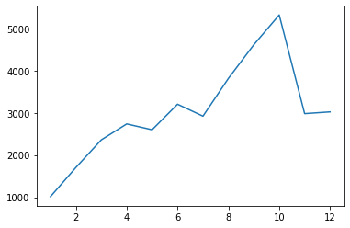
# On Overall picture we see that there is gradual increase in bookings, but there is sudden dip in bookings in November and December
# Same pattern is follwed in cancellation percentage, but percentage is very high in june and july, keeps decreasing August to December

Slide 14
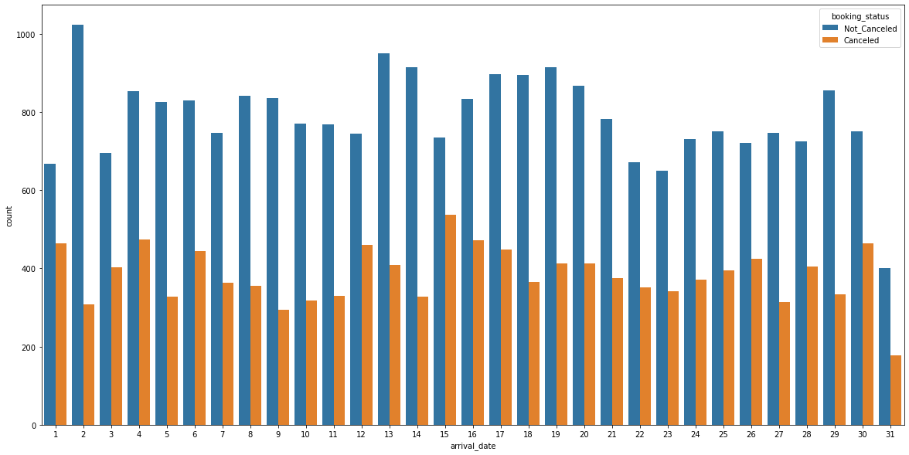

Slide 15
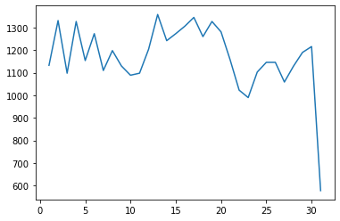
# Cancellation percentage is almost same across all days, but we see a sudden dip in booking in the month end

Slide 16
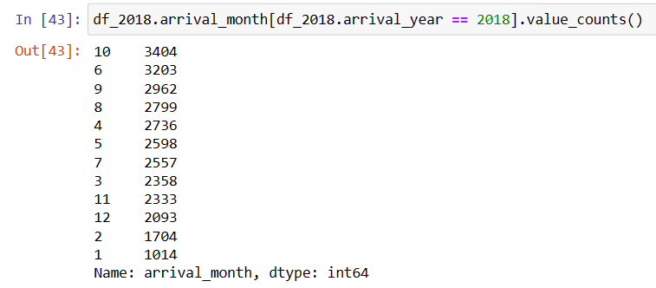
We will analyze data separately for 2018

Slide 17
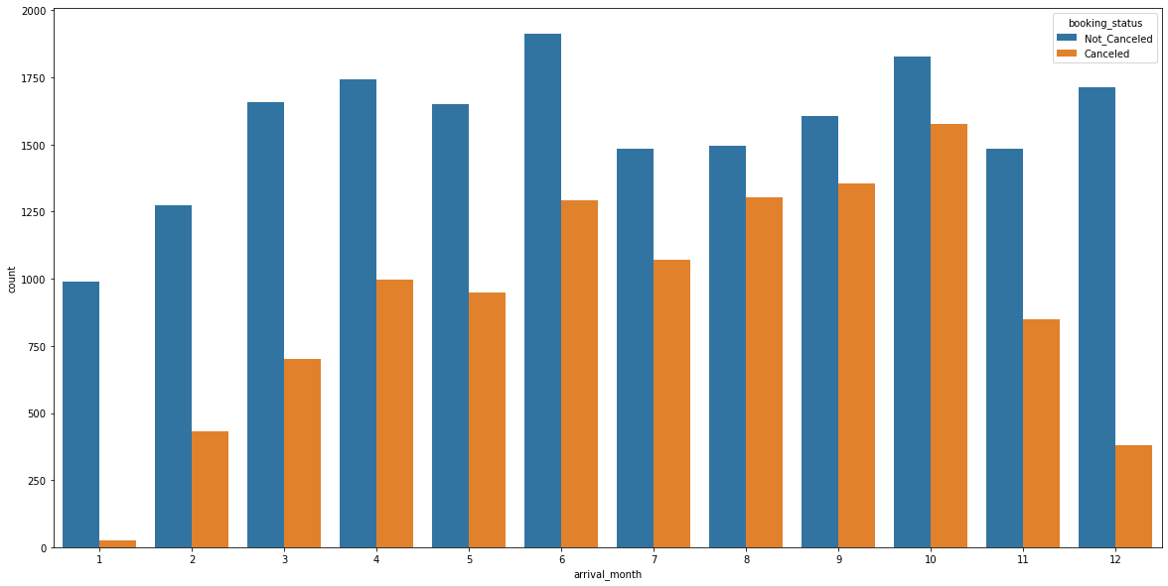

Slide 18
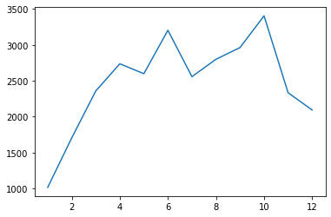
Count of Arrival Month Wise
Count
Arrival Month

Slide 19
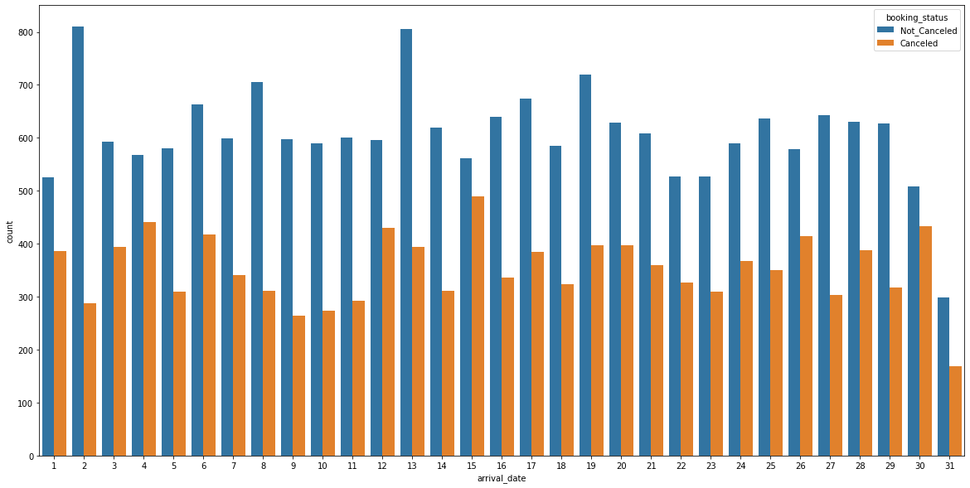

Slide 20
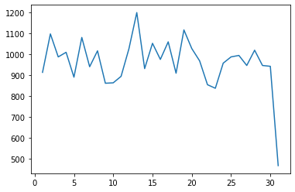
Count of Arrival Month Wise
Count
Arrival Date
# We see that similar pattern is followed for data in 2018 as for overall data

Slide 21
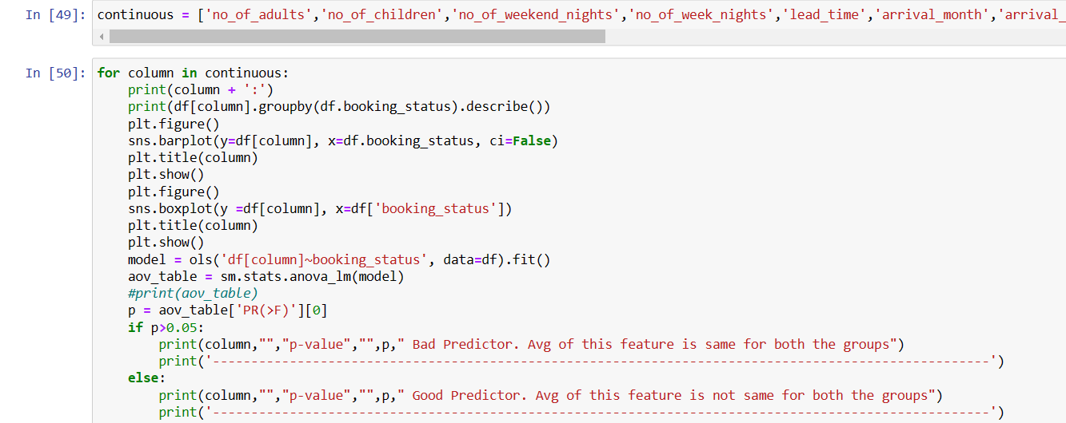

Slide 22
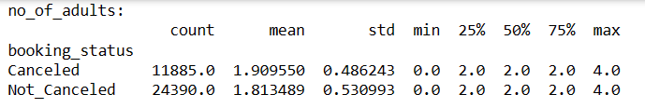
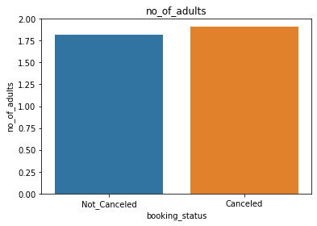
no_of_adults p-value 8.848338257094206e-62 Good Predictor. Avg of this feature is not same for both the groups

Slide 23
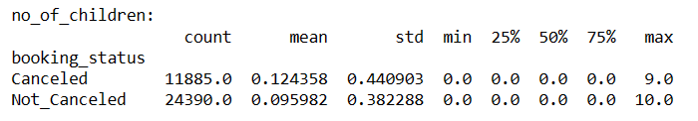
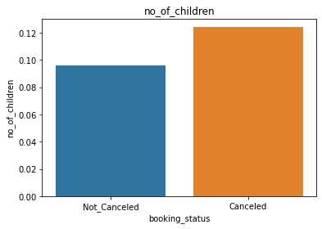
no_of_children p-value 2.947637376831079e-10 Good Predictor. Avg of this feature is not same for both the groups

Slide 24
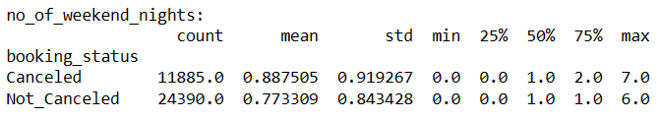
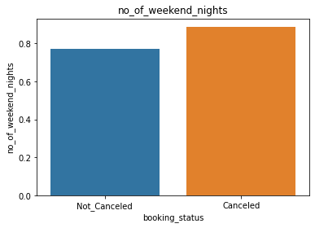
no_of_weekend_nights p-value 8.340701585971926e-32 Good Predictor. Avg of this feature is not same for both the groups

Slide 25
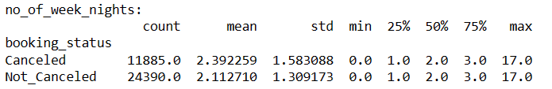
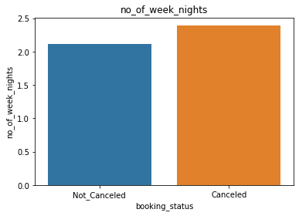
no_of_week_nights p-value 1.7272158751415455e-70 Good Predictor. Avg of this feature is not same for both the groups

Slide 26
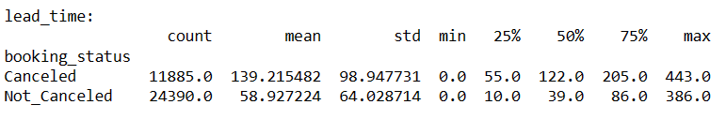
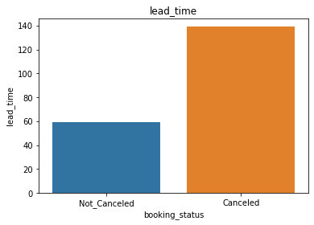
lead_time p-value 0.0 Good Predictor. Avg of this feature is not same for both the groups

Slide 27
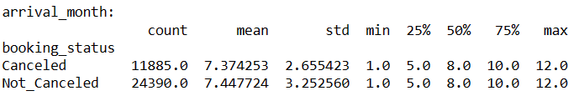
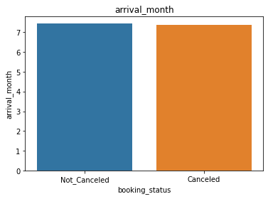
arrival_month p-value 0.03239997582757596 Good Predictor. Avg of this feature is not same for both the groups

Slide 28
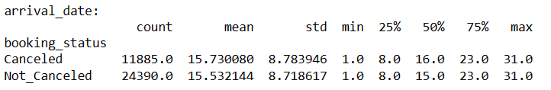
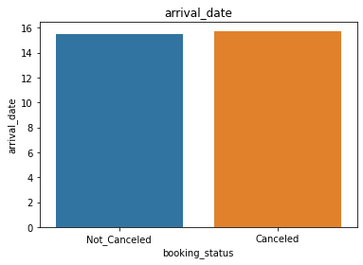
arrival_date p-value 0.04292948340681466 Good Predictor. Avg of this feature is not same for both the groups

Slide 29
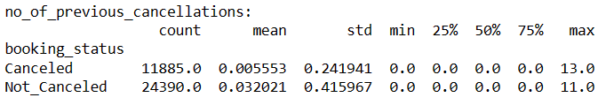
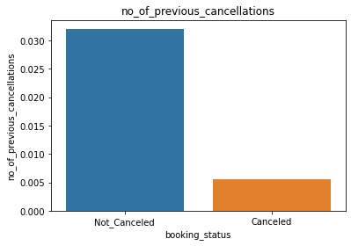
no_of_previous_cancellations p-value 1.3152065000503417e-10 Good Predictor. Avg of this feature is not same for both the groups

Slide 30
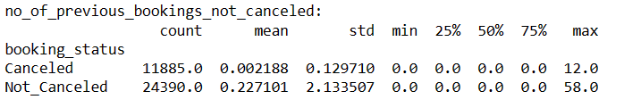
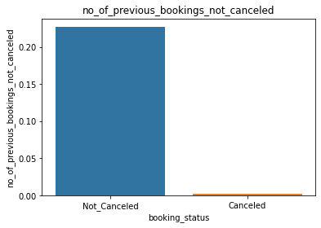
no_of_previous_bookings_not_canceled p-value 1.8287364128686035e-30 Good Predictor. Avg of this feature is not same for both the groups

Slide 31
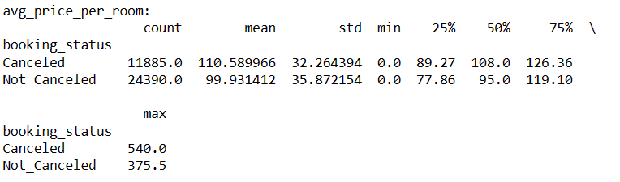
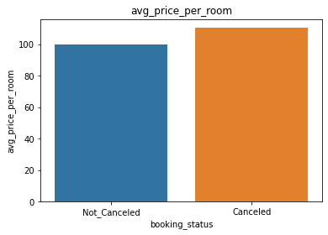
avg_price_per_room p-value 5.2303189247998436e-164 Good Predictor. Avg of this feature is not same for both the groups

Slide 32
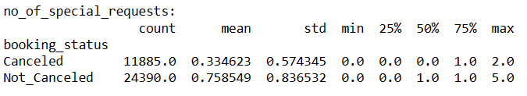
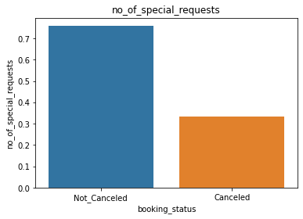
no_of_special_requests p-value 0.0 Good Predictor. Avg of this feature is not same for both the groups

Slide 33
# cancellation of booking doesn't show much difference wrt no.adults
# same pattern is follwed wrt to no.of children, but we see a slight tendency that more no. of children leads to more cancellation
# we see a slight tendency that more no. of weekend nights leads to more cancellation
# we see same pattern with more no. of week nights.
# This means longer booking are more prone to get cancelled
# Cancellation percentage is higher for people whose lead time is higher. This means people who are taking more time to book
# have more chances to cancel
# month and date of arrival is not affecting the cancellation percentage
# People with higher number of previous cancelation have lesser chance of cancelation
# People with high number of non-cancellation have very high percentage of non cancelation
# Overall we can say chance of not cancelling booking is high
# We don't see much difference in avg_price for cancelled and not cancelled group
# People who make more special tend not to cancel booking

Slide 34
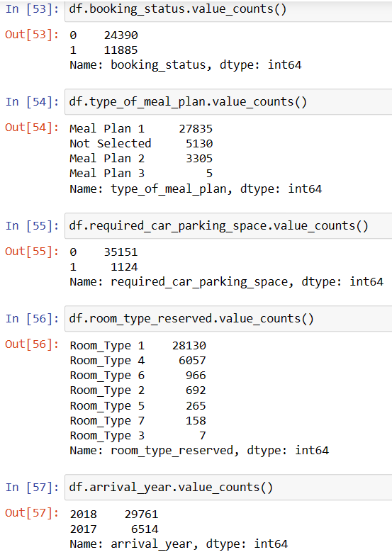
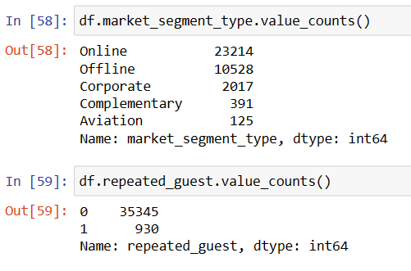

Slide 35

df.type_of_meal_plan.replace(['Not Selected', 'Meal Plan 1', 'Meal Plan 2', 'Meal Plan 3'], [0,1,2,3], inplace=True)

Slide 36


Slide 37


Slide 38


Slide 39

df.room_type_reserved.replace(['Room_Type 1', 'Room_Type 2', 'Room_Type 3', 'Room_Type 4', 'Room_Type 5', 'Room_Type 6', 'Room_Type 7'], [1,2,3,4,5,6,7], inplace=True)

Slide 40


Slide 41

df.arrival_year.replace([2017,2018], [1,2], inplace=True)

Slide 42


Slide 43

df.market_segment_type.replace(['Online', 'Offline', 'Corporate', 'Complementary', 'Aviation'],[1,2,3,4,5], inplace=True)

Slide 44


Slide 45


Slide 46


Slide 47




Slide 48

We can see data is not linearly seperable

Slide 49


Slide 50



Slide 51



Slide 52



Slide 53



Slide 54



